Slide 1
Design Transmitter Driver matching impedance @ 5Gb/s
Báo cáo Đồ án 1 - HK 242
Giảng viên hướng dẫn: Thầy Trần Hoàng Linh
Cùng: Anh Đỗ Huy Khang

Slide 2
Sinh viên thực hiện:
Tên | MSSV
Hà Lê Ngọc Hưng | 2211358

Slide 3
Contents
Overview
Project Tasks
Analysis of Design Requirements
Circuit Design
Implementation Results
Conclusions and Future Work
References

Slide 4
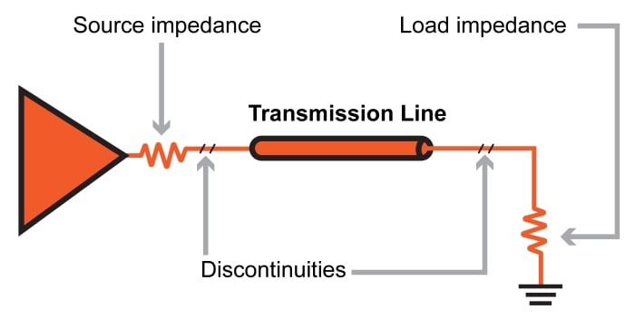
Why we need a TX driver in high-speed transmitters?
Provides impedance matching and fast edges to maintain signal integrity
Ensures the correct voltage swing and drive strength to overcome channel losses
Compensates for PVT variations so that output impedance remains at 50 Ω
Supports multiple communication standards with adjustable features

Slide 5
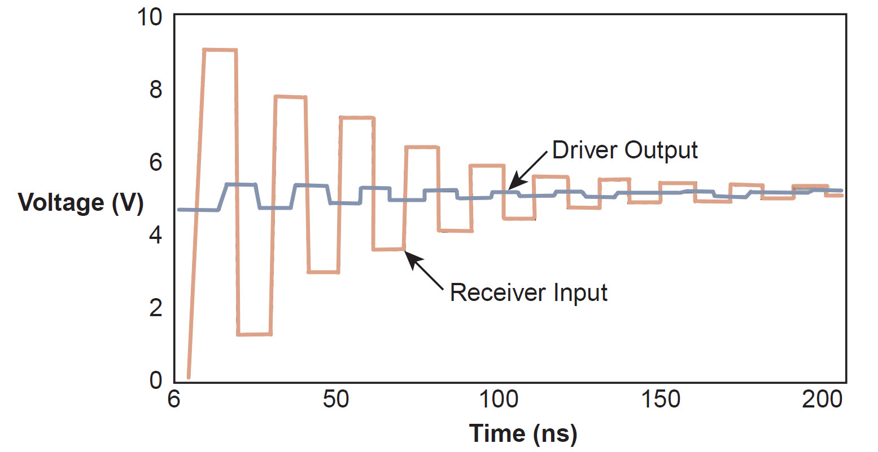
Signal reflections due to impedance mismatch
Introduction
Reflections bouncing back and forth on mismatched transmission lines can produce a step-like response in the voltage observed at both the receiver and the source. This step response may manifest as a gradual increase in signal level (see the example below), or as a series of rising-and-falling steps—both of which interfere with subsequent signals
It is necessary to ensure good impedance matching on the transmission line

Slide 6
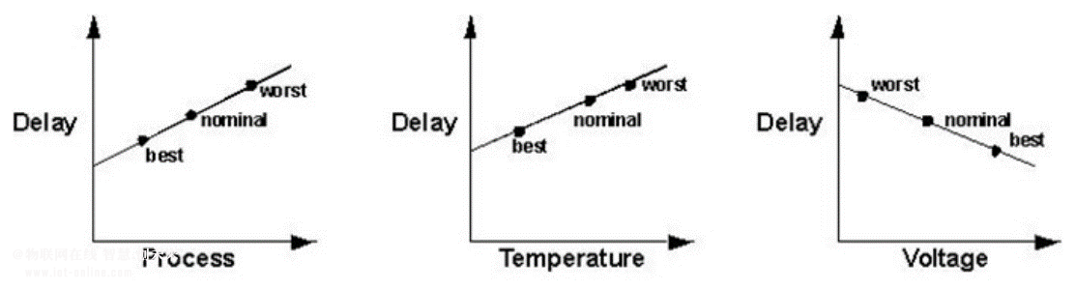
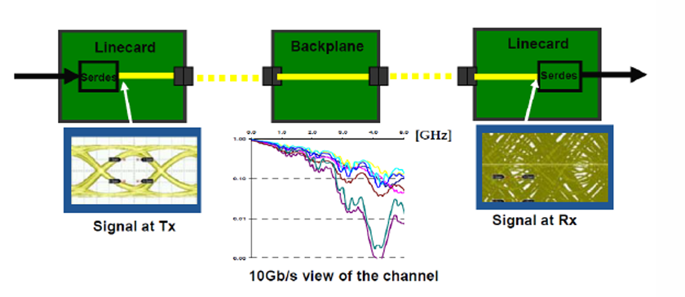
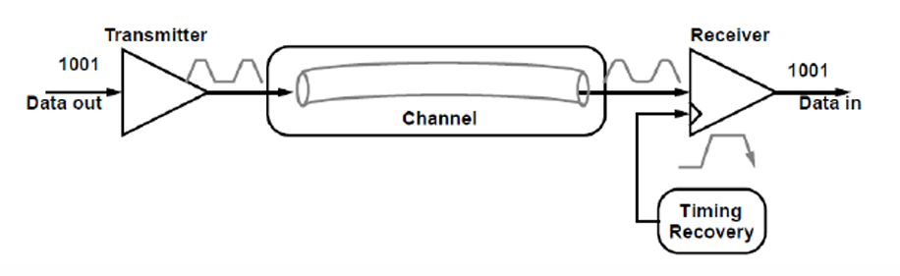

Slide 7
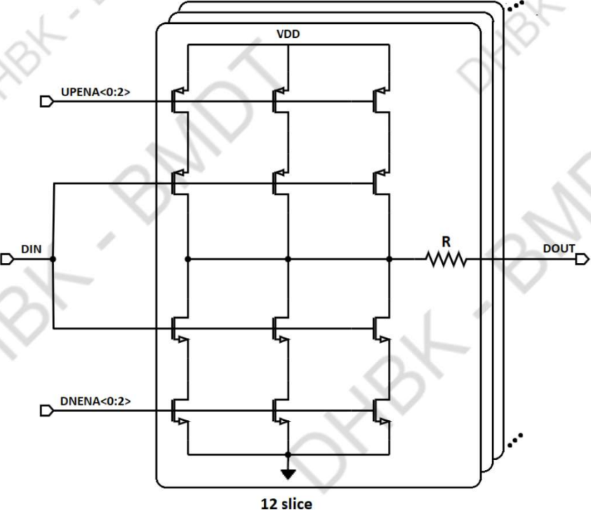
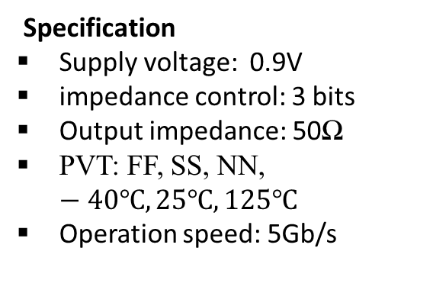
Design a driver circuit for a transmitter operating at 5 Gb/s. Implemented with a P-over-N architecture and special trimming bits, this design helps maintain stable impedance during operation. The system includes a background impedance calibration feature, allowing the driver to function accurately under process, voltage, and temperature (PVT) variations, in order to achieve a 50Ω output impedance.
Project Task and Design Requirements
Specification
Supply voltage: 0.9V
impedance control: 3 bits
Output impedance: 50Ω
PVT: FF, SS, NN, $−40℃,25℃,125℃$
Operation speed: 5Gb/s
Requirement : Develop the circuit architecture, implement the testbench, and measure the required parameters
Measure output impedance (pull-up và pull-up)
Simulate with prsb source and measure rise/fall time và duty cycle
Meausre jitter

Slide 8
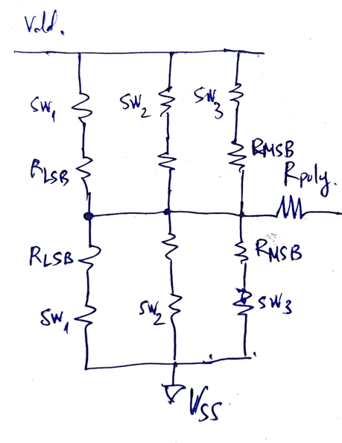

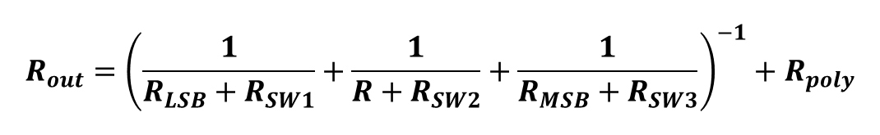

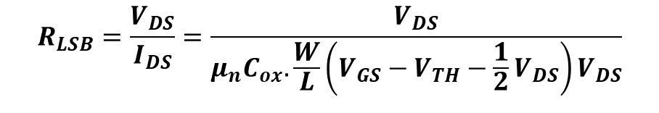
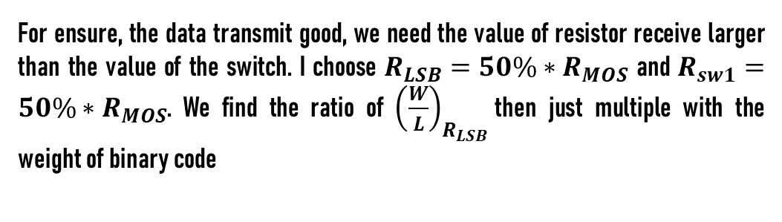
$$R_{out}={\left(\frac{1}{R_{LSB}+R_{SW1}}+\frac{1}{R+R_{SW2}}+\frac{1}{R_{MSB}+R_{SW3}}\right)}^{−1}+R_{poly}$$
Analysis circuit
$$R_{LSB}=\frac{V_{DS}}{I_{DS}}=\frac{V_{DS}}{μ_{n}C_{ox}.\frac{W}{L}\left(V_{GS}−V_{TH}−\frac{1}{2}V_{DS}\right)V_{DS}}$$
Ids
$$R_{LSB}=\frac{1}{μ_{n}C_{ox}.\frac{W}{L}(V_{GS}−V_{TH})}$$
If $V_{DS}≪V_{GS}−V_{TH}$, $R_{LSB}$ is not depended on $V_{DS}$
Choose $R_{poly}=350Ω ⟹R_{MOS}=250Ω$
For ensure, the data transmit good, we need the value of resistor receive larger than the value of the switch. I choose $R_{LSB}=50\%∗R_{MOS}$ and $R_{sw1}=50\%∗R_{MOS}$. We find the ratio of ${\left(\frac{W}{L}\right)}_{R_{LSB}}$then just multiple with the weight of binary code

Slide 9
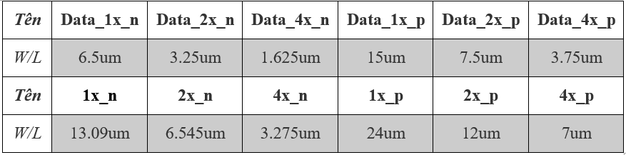
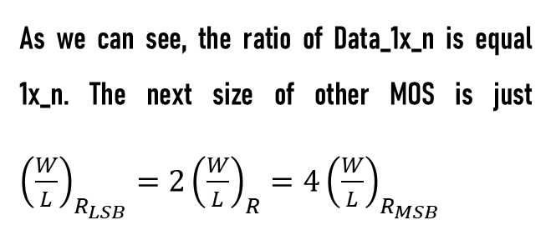

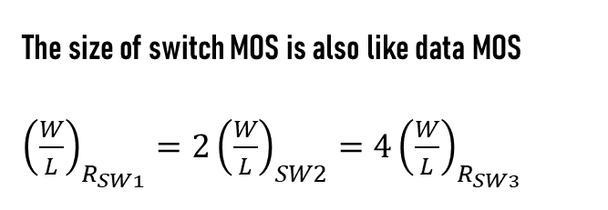
Here is the ratio of (W/L) all MOS
As we can see, the ratio of Data_1x_n is equal 1x_n. The next size of other MOS is just ${\left(\frac{W}{L}\right)}_{R_{LSB}}=2{\left(\frac{W}{L}\right)}_{R}=4{\left(\frac{W}{L}\right)}_{R_{MSB} }$
The size of switch MOS is also like data MOS ${\left(\frac{W}{L}\right)}_{R_{SW1}}=2{\left(\frac{W}{L}\right)}_{SW2}=4{\left(\frac{W}{L}\right)}_{R_{SW3} }$
We consider the effective of leakage current of MOS , because the leakage of PMOS is larger than NMOS, so ${\left(\frac{W}{L}\right)}_{PMOS}≈2.5{\left(\frac{W}{L}\right)}_{NMOS}$

Slide 10
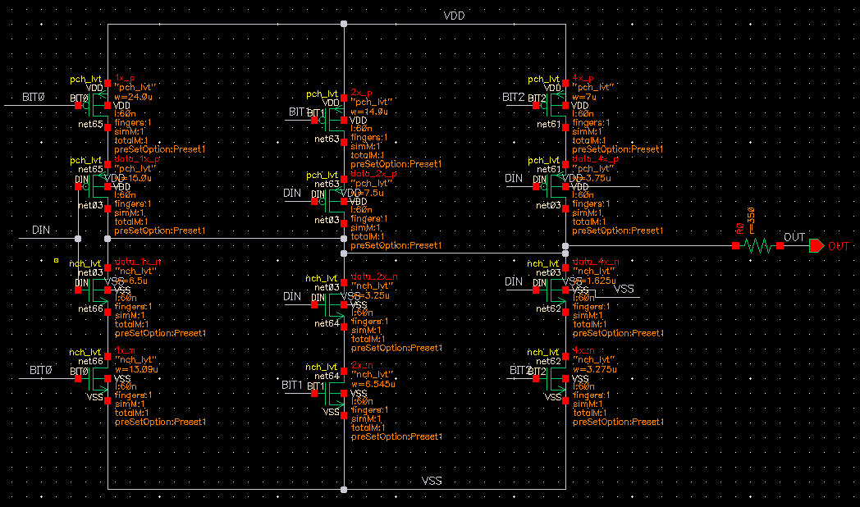
Schematic of the circuit ( 1 slice )
Design circuit

Slide 11
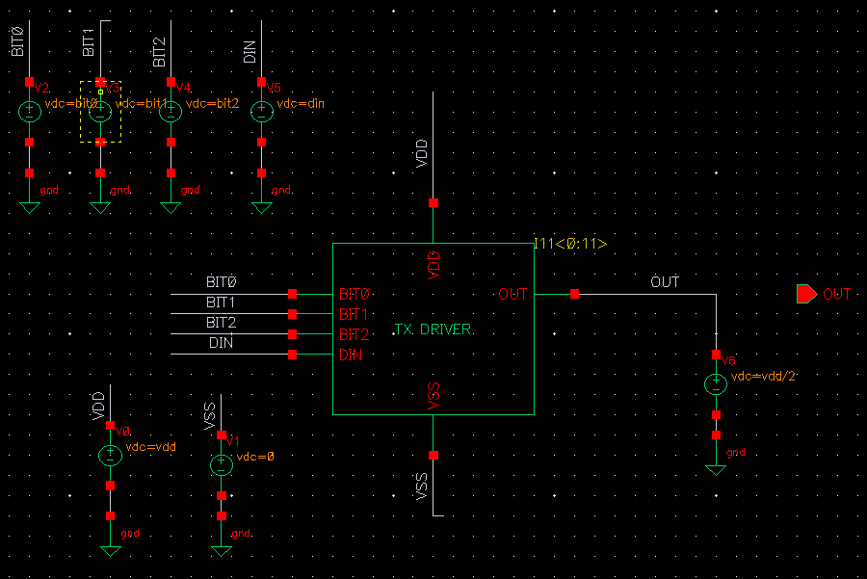
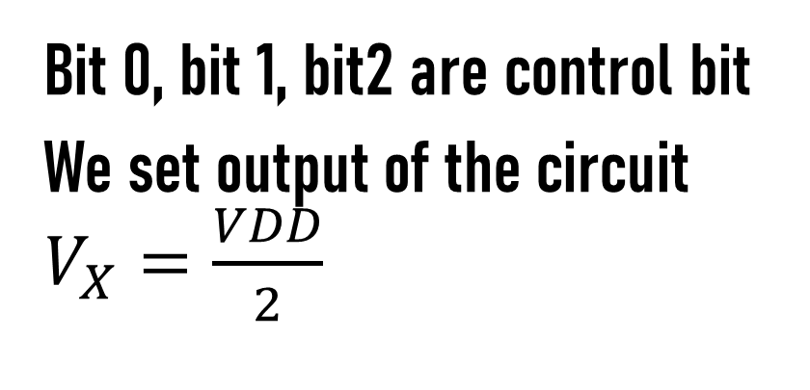

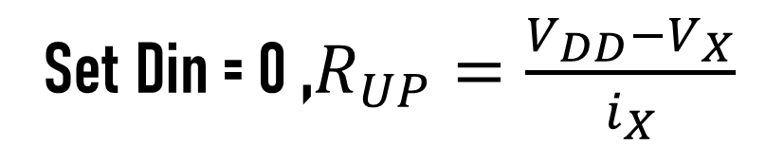
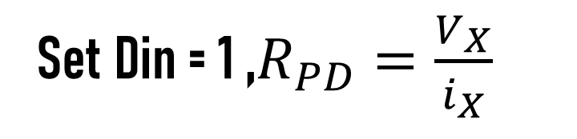
Testbench for measure $R_{PD} \& R_{UP}$
Simulate result
Bit 0, bit 1, bit2 are control bit
We set output of the circuit $V_{X}=\frac{VDD}{2}$
Set Din = 1 ,$R_{PD}=\frac{V_{X}}{i_{X}}$
Set Din = 0 ,$R_{UP}=\frac{{V_{DD}−V}_{X}}{i_{X}}$

Slide 12
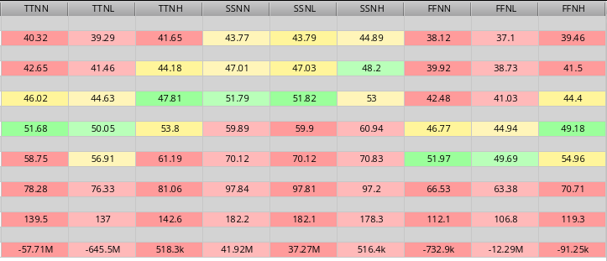
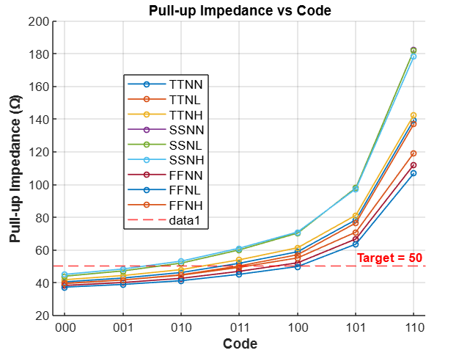

OUTPUT IMPEDANCE $R_{UP}$
We have at code 011, the output impedance is nearly the target impedance $50Ω$

Slide 13
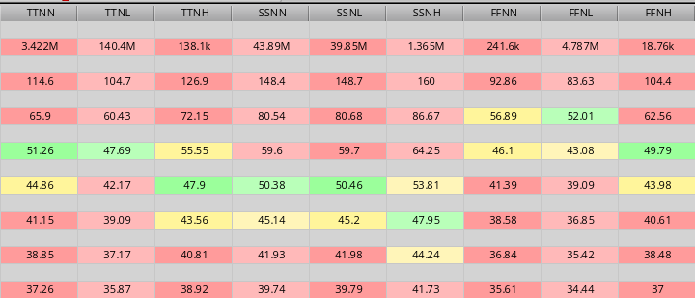
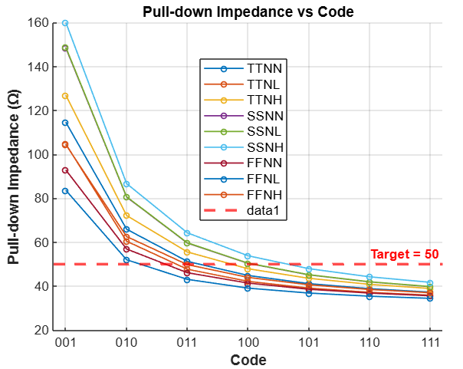

OUTPUT IMPEDANCE $R_{DN}$
Similarly , we have at code 011, the output impedance is nearly the target impedance $50Ω$

Slide 14
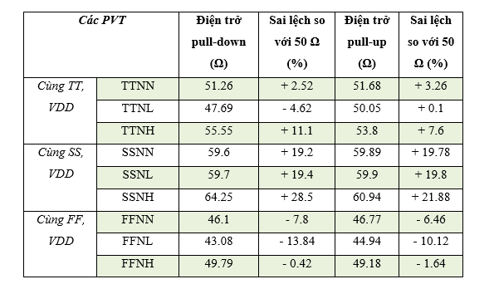
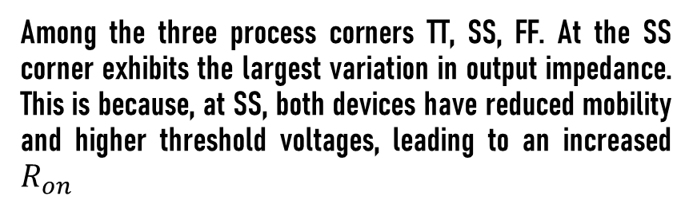

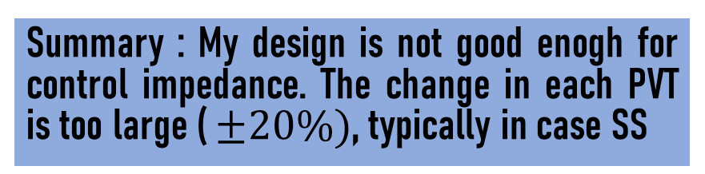
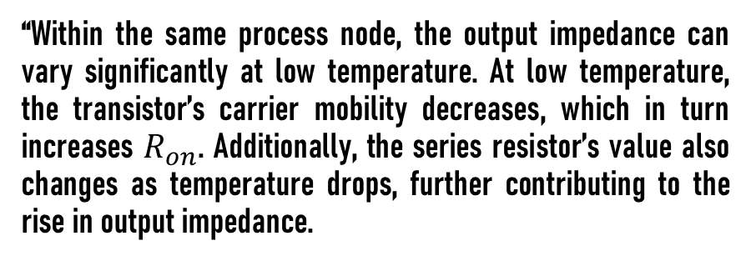
Compare $R_{DN} \& R_{UP}$ in 9 PVT
Among the three process corners TT, SS, FF. At the SS corner exhibits the largest variation in output impedance. This is because, at SS, both devices have reduced mobility and higher threshold voltages, leading to an increased $R_{on}$
“Within the same process node, the output impedance can vary significantly at low temperature. At low temperature, the transistor’s carrier mobility decreases, which in turn increases $R_{on}$. Additionally, the series resistor’s value also changes as temperature drops, further contributing to the rise in output impedance.
Summary : My design is not good enogh for control impedance. The change in each PVT is too large ( $±20\%)$, typically in case SS

Slide 15
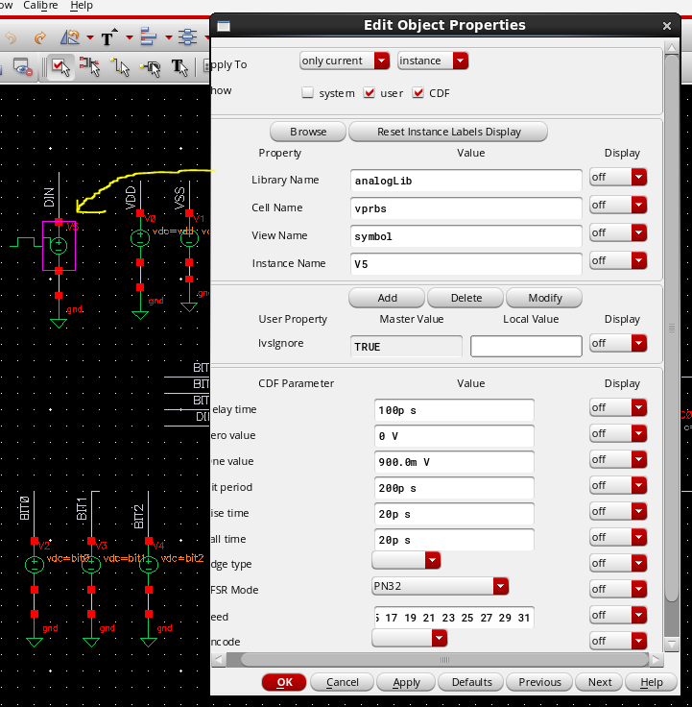
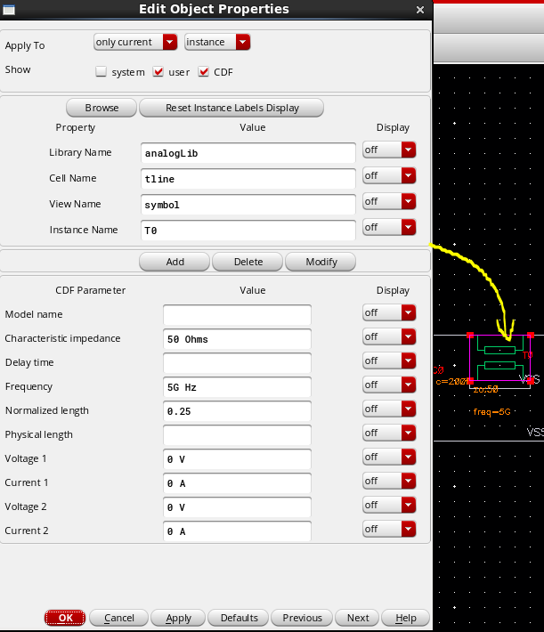
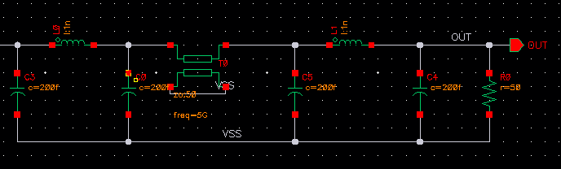
Measure parameter with prbs source
We need to config some parameter for prbs source first

Slide 16
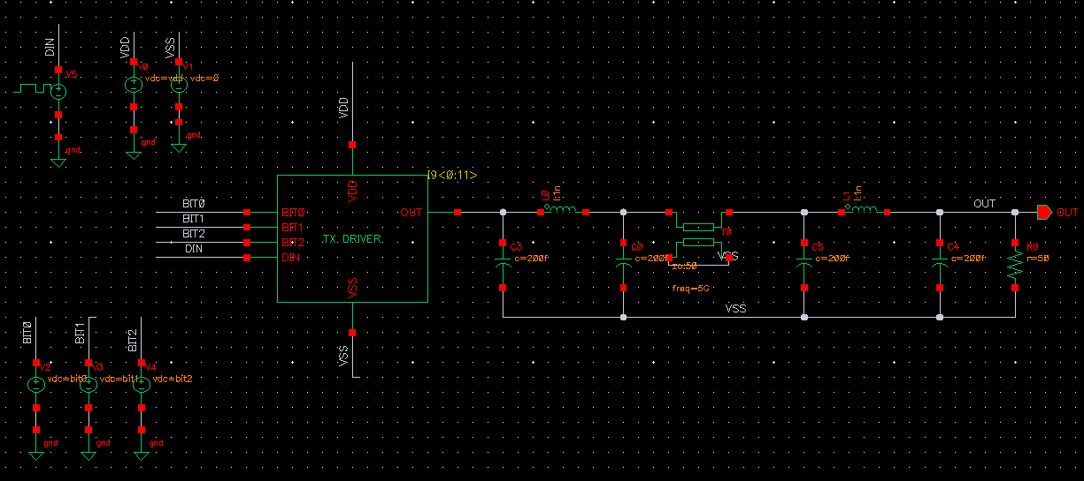
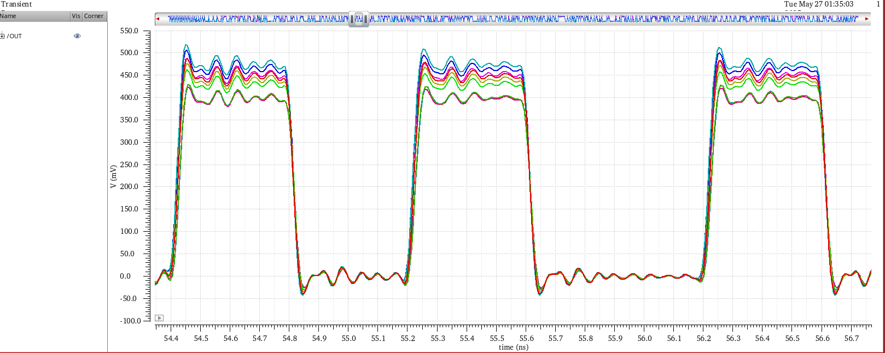
Testbench for measuring
overshoot
Too much overshoot, ringing
Slow settling time

Slide 17
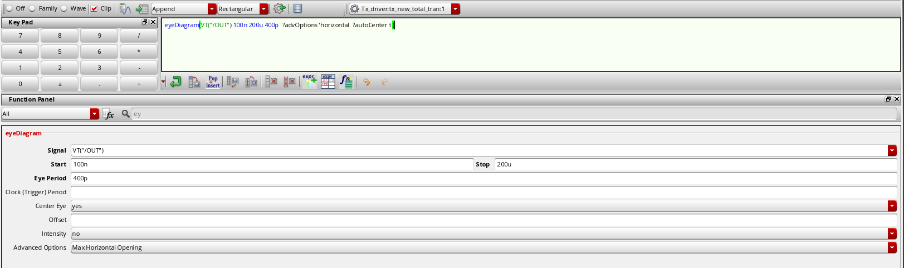
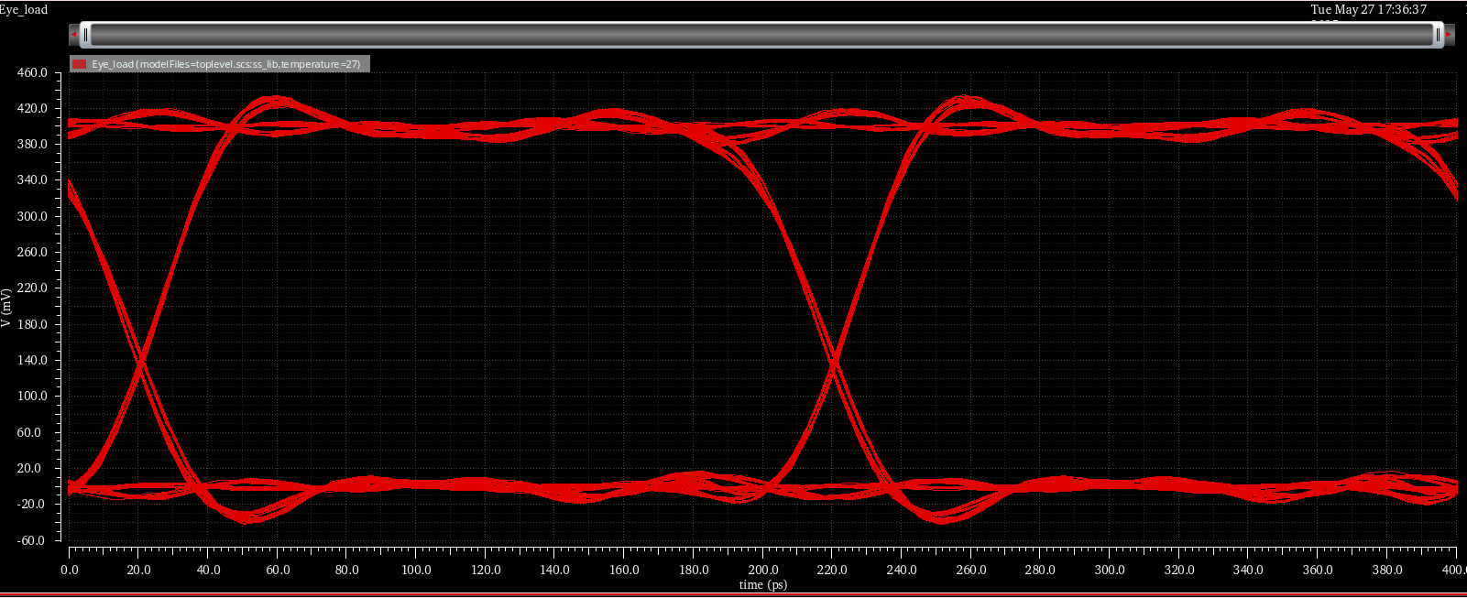
For measure tfall , trise , duty cycle and jitter we use Eye diagram
2*UI
We have Eye diagram example like this

Slide 18
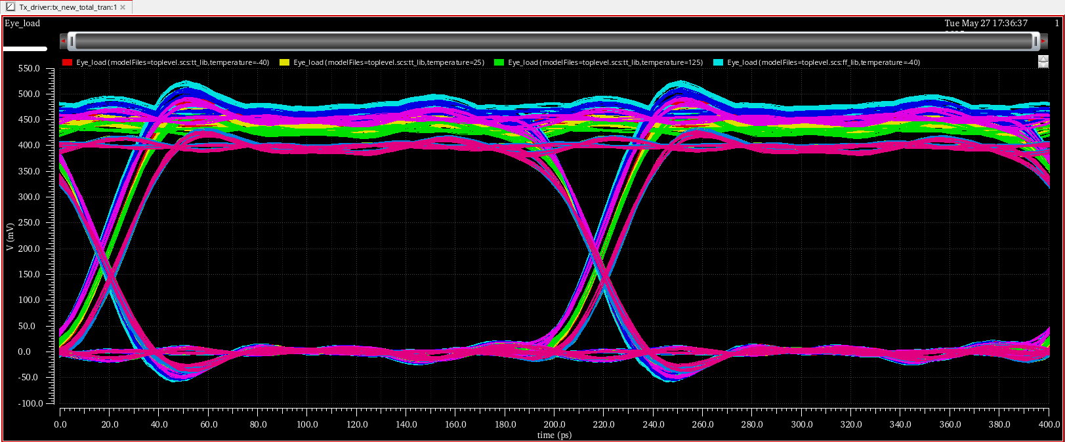
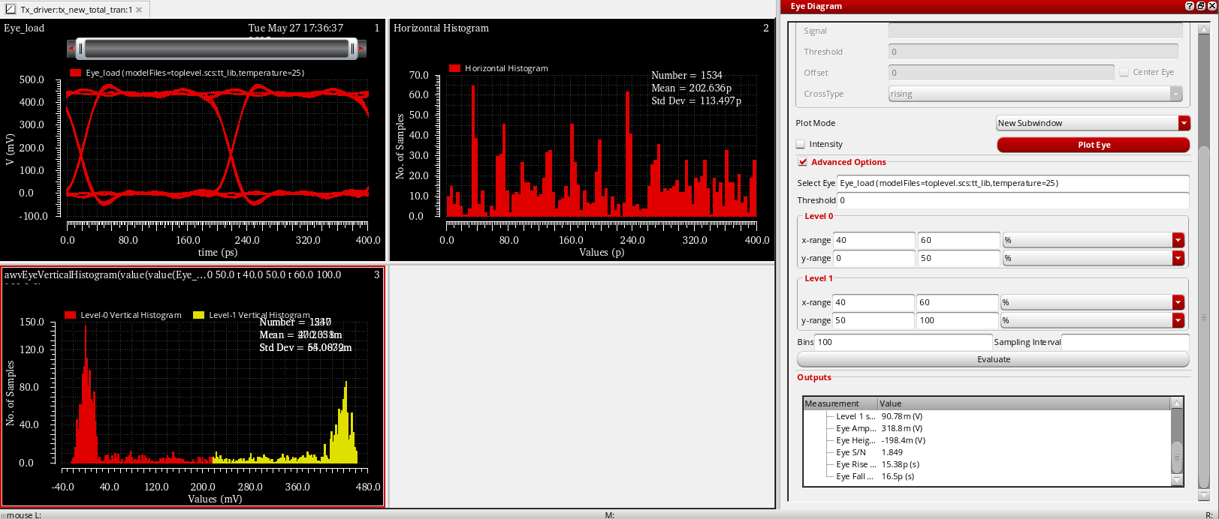
Eye diagram of 9 PVT
The reflect of signal -> make ISI
Time for logic “0” is not equal time logic “1”
0.72UI
Measure trise, tfall
Eye diagram of 9 PVT
On “Eye diagram” window -> click Tool -> Eye digram -> click Advance Option -> Choose name of signal we want
Choose “Threshold “ 0 , Bin = 100 -> OK

Slide 19
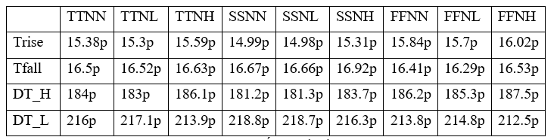

Table value of 9 PVT
The rising/falling time of edge is good
All value trise, tfall are smaller than 20 ps (standard for 5 Gb/s )
DT_H and DT_L are larger than 100 ps (standard for 5 Gb/s )
For 5 Gb/s -> $DT_{H}=DT_{L}≈100ps$ -> not match

Slide 20
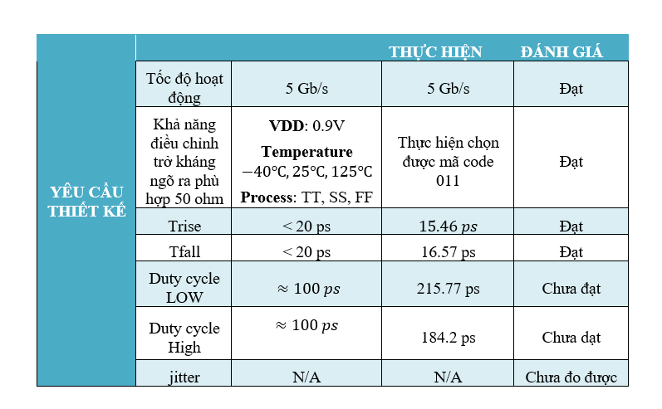
Summary

Slide 21
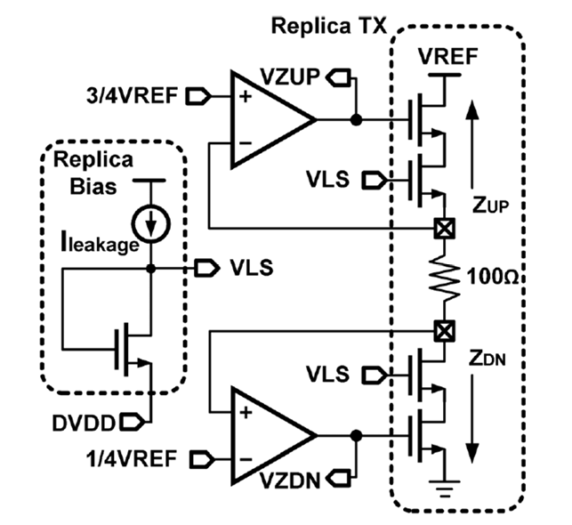
Future Work
Low-Swing Voltage-Mode Driver
Replica global impedance control loop provides analog gate voltages to the additional top/bottom transistors to set the pull-up/down impedance

Slide 22
References
Sam Palermo, “ECEN720: High-Speed Links Circuits and Systems Spring 2025”
Woorham Bae and Deog-Kyoon Jeong, “A power-efficient 600-mVpp voltage-mode driver with independently matched pull-up and pull-down impedances”, 2014.
Miao Bai, Xiaofei Wang, Jing Jin, Tingting Mo, “An Impedance Calibration Method Based on Temperature and Process Monitor for LPDDR5 Interface”, 2021

Slide 23
Thank you

